Slide 1
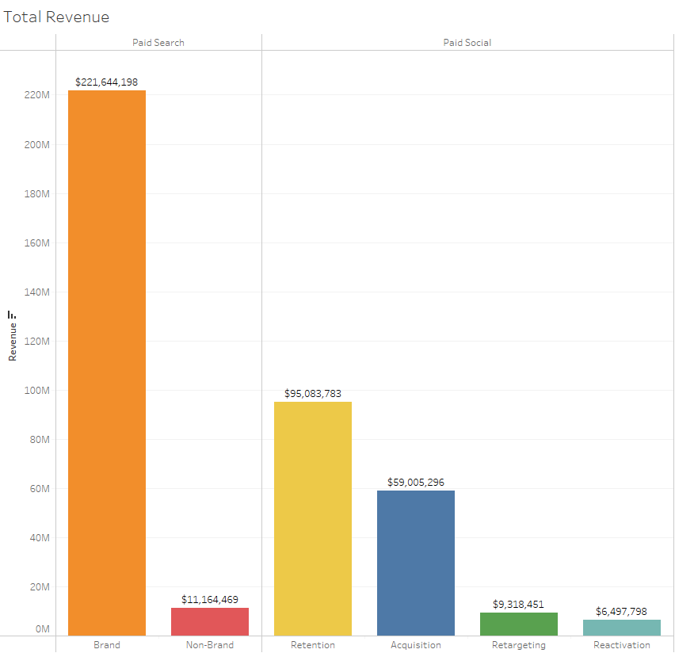
Octopi Business Review
BUSINESS PERFORMANCE OVERVIEW
Top Revenue Drivers: Brand and Retention
Top Drivers of New Customers: Retention and Acquisition
STRATEGIC RECOMMENDATION
Increase investment by allocating more budget to Brand and Retention to drive high revenue and new customer growth. Maintain or lower budget on Acquisition. Reduce budget on Retargeting, Reactivation, and Non-Brand.
SUPPORTING POINTS
Brand Paid Searches have the highest ROAS with $134 and Retargeting has the lowest ROAS with $2.6
Brand generates more revenue than all the other channels combined.
Brand had the lowest CPC ($0.07 with Acquisition the highest $23.58).
Reactivation brings in the lowest revenue out of all the other channels, but has the second highest CPC at $20.71.
Non-Brand Paid Searches had the highest CPO at $19.42, while the others all had sub dollar costs.
Retention attracted 71,653 new customers in 2022, a whopping 177.75% increase from 2022. Acquisition has achieved similar success with 92,113 new customers in 2022, a 163% increase from 2020.
Brand has seen the most drastic reduction in attracting new customers. A 60.35% decrease from 2020. As the main revenue driver of the company, failure to attract new customers by this channel can see a slowing down or even reduction in total revenue in the future.

